Slide 1
MM
27/5/63

Slide 2
Patient profile
ชาย 37 ปี
ภูมิลำเนา อำเภอเมือง จังหวัดนครปฐม

Slide 3
Present illness
2 เดือนก่อนมารพ. ตัวเหลืองตาเหลือง เหลืองมากขึ้นเรื่อยๆ คันตามตัว อุจจาระสีซีด ปัสสาวะสีเข้มขึ้น ไม่มีไข้ ไม่คลื่นไส้/อาเจียน ไม่ปวดท้อง น้ำหนักลด10กิโลกรัมใน2เดือน
มีประวัติดื่มสุรามา 20 ปี เลิกมา 1 ปี
ไม่เคยมีประวัติติดเชื้อตับอักเสบหรือเคยได้รับเลือดมาก่อน
ไม่มีประวัติมะเร็งในครอบครัว
ไม่เคยผ่าตัด

Slide 4
Physical examination
BT 37.2 PR 82 RR 20 BP120/80
Marked jaundice, not pale
Abdomen: mild distend, not tender, no mass, no sign of chronic liver disease
LN: can’t palpable at supraclav., periumbilical
PR: no mass

Slide 5
lab
LFT:
- Alb/Glo = 3.3/3.3
- AST/ALT/ALP = 263/57/263
- TB/DB = 22.49/10.4
CBC
- WBC 7110 (NE 51%, L32%)
- Hb/Hct = 14/40%
- Plt = 255000
INR 1.77

Slide 6
LAB
Electrolyte:
- Na = 133
- K = 4.0
- Cl = 100
- CO₃ = 22
BUN = 14
Cr = 0.77
CA19-9 = <2
Anti-HAV/HCV/HIV negative
HBsAg negative

Slide 7
CT
Well-defined infiltrative inhomogeneous enhancing soft tissue mass involving at pancreatic head/ampullary region, sized 2.2x2.4x2.3 cm
Aforementioned lesion has also abrupted change of middle two-third of CBD, causing upstream dilatation of middle two-third of CBD (1.8 cm in maximal diameter), CHD and both IHDs.
Also seen main pancreatic duct dilatation (0.6 cm in caliber) is noted

Slide 8
diagnosis
Locally advance CA ampulla
>> set OR for
Whipple operation(pancreaticoduodenectomy)

Slide 9
Operation
Findings:
3cm. Ampulla mass invade head of pancreas
Bile duct size 2 cm.
Pancreatic duct 6 mm.
Accidentally transected common hepatic artery

Slide 10
Operation
Cholecystectomy
Bile duct transection
Encircle neck of pancreas
Rt. Gastric artery and GDA ligation
Divided of proximal jejunum, duodenum, and neck of pancreas
Dissection of uncinate process, head of pancreas from SMV
Accidentally transected of common hepatic artery

Slide 11
Operation
Harvesting GSV
Embolectomy proximal and distal stump of the transected artery
Pancreatico-jejunostomy anastomosis
Hepatico-jejunostomy anastomosis
Duodeno-jejunostomy anastomosis
Rt.JPD was placed postorior to HJ
Lt.JPD was placed anterior to PJ

Slide 12
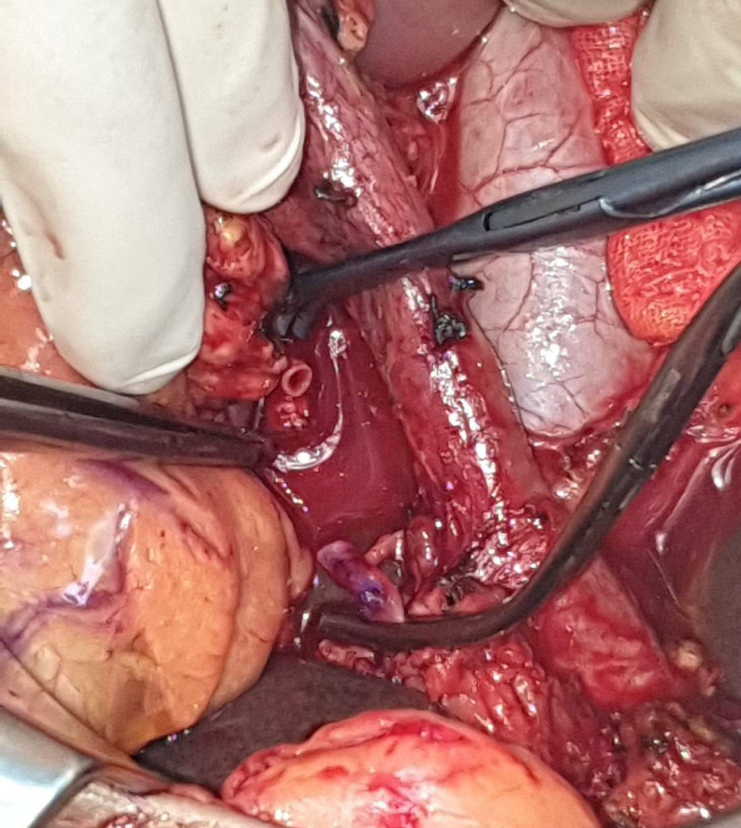
operation
- Repair common hepatic artery with interposition saphenous vein graft

Slide 13
Post operation
 |  |  | rt | lt | HD
Day1 | Urine 175 ml/day, BT 39.4 |  | 880 | 90
 | Lab: WBC 20040 / INR 2.99 / Cr.2.11 / AST8432 / ALT1478 / ALP2264 INR 2.99 | Albumin + Lasix IV Fluid ATB: Tazocin VitK + FFP
Day2 | urine 40 ml/day | Consult Nephro > HD emer ATB: Mero+vanco | 680 | 700 | 1800
Day4 | Rt.JD for TB=19.49 Serum TB=20.65 |  | 550 | 280 | 2400
Day5 | BT 38 urine ไม่ออก AST174 / ALT669 / ALP381 TB17.26 / DB 9.28 | เริ่ม feed drip BD | 145 | 830
Day6 | Cr9.35, no fever | PSV mode | 500 | 850 | 2000
Day7 | No dyspnea | Off ET tube | 600 | 400

Slide 14
Post operation
 |  |  | rt | lt | HD
day8 |  | Step feed 60x5hr x 4 feeds | 250 | 350 | 1200
day9 | No urine | Soft diet โรคไต | 200 | 650
day10 | Drain TB rt. 9.05 Lt.6.12 AST102 / ALT48 / ALP483 TB10.84 / DB 6.11 |  | 270 | 450
Day14 |  | CT follow up | 10 | 270
Day17 | No fever Urine 150 ml/day | Off mero+vanco (14days) | - | 200
Day19 |  | Off rt.JD
Day21 | Urine 350 ml/day Cr = 12.71 | Lasix(500)1/2x2 |  | 50 | 2000
Day22 | BT=38x2 peak | Septic work up Start tazocin |  | 190

Slide 15
Post operation
 |  |  | lt | HD
Day25 | Drain for amylase 393 Drain for TB 18.6 AST25/ ALT20 / ALP264 TB2.27 / DB 0.98 Amylase 106 Urine 1800 |  | 320
Day28 | Urine 1400 | Drip albumin | 800
Day30 | Urine 900 Cr=11.22 Drain for TB 9.00 | Continue NSS 80 ml/hr | 2040 | 1300
Day31 | Drain for amylase 7865 Drain for TB 12.51 |  | 2260
Day43 | BUN28 / Cr 3.20 | Off drain | ไม่ออก7วัน

Slide 16
patho
- Well- differentiated adenocarcinoma
2.3x2x1.5 cm at ampulla of vater
Invade pancreas
No Lymph node metastasis(0/12)
CBD/pancreatic margin/proximal and distal margin = not involve by carcinoma

Slide 17
CT
- Newly-developed contiguous non-enhancing hypodense lesions (up to 3.4x4.7-cm) adjacent and underneath the pancreaticojejunostomy
<<

Slide 18
Problem list
Accidentally transected common hepatic artery
Liver failure
AKI
PJ leakage

