Slide 1
Interesting Case

Slide 2
Interesting Case
Case ผู้ป่วยหญิงอายุ 87 ปี
CC: แขนขวาอ่อนแรง 6 ช.ม PTA
PI: 6 hr PTA รู้สึกปวดแขนขวามาก อ่อนแรง ขยับได้น้อยลง ญาติพบร้องปวด จึงพามา ร.พ.

Slide 3
Interesting Case
โรคประจำตัว: old fracture neck of femur ปี 2558
Status เดิม bed ridden 6 ปี ไม่ทราบสาเหตุ
ปฏิเสธการแพ้ยา แพ้อาหาร
ปฏิเสธประวัติดื่มสุรา และสูบบุหรี่
ไม่เคยมีประวัติผ่าตัดมาก่อน
ไม่เคยมีประวัติอุบัติเหตุรุนแรงมาก่อน

Slide 4
Interesting Case
PE: BT 37.5 C, PR 160 bpm, RR 22/min, BP 110/80 mmHg
General Appearance: A Thai female, good consciousness
HEENT: Not pale conjunctivae, anicteric sclera
Lymph Node: No superficial lymphadenopathy
CVS: Irregular pulse, no murmur
RS: Clear, no adventitious sound

Slide 5
Interesting Case
Abdomen: No distension, soft, not tender, no rebound tenderness, no guarding, no mass
Extremities: Pallor,purplish skin, poikilothermic at Rt. upper extremities, decrease sensation, capillary refill ~ 5 sec, muscle gr I
Peripheral pulse Rt. Lt. Radial Artery 0+ 2+ Ulnar Artery 0+ 2+ Brachial Artery 0+ 2+ Axillary artery 1+ 2+

Slide 6
Problem List
Pain, Purplish Skin, Paresthesia,Poikilothermia and decreased motor power Right extremities
→Acute Limb Ischemia

Slide 7
Provisional diagnosis
“Acute limb ischemia IIb (right upper extremities)”

Slide 8
Initial management
• CBC, BUN, Cr, electrolyte
• PT, PTT, INR • EKG 12 leads • Heparin 80 U/kg
then heparin (100:1) IV drip 18 U/kg/hr
• CTA upper extremities

Slide 9
CTA
Acute Arterial occlusion at right axillary artery
Absent of contrast opacification in right radial artery and right ulnar artery
Atherosclerotic change visible aortic arch with eccentric intraluminal thrombus

Slide 10
Investigation
BUN/Cr & Electrolyte BUN 21 mg/dL Creatinine 1.21 mg/dL Sodium 130 mmol/L Potassium 3.6 mmol/L Chloride 102 mmol/L Bicarbonate 20 mmol/L
CBC WBC 7580/ul Hb 12.6 g/dL Hct 36 % Plt 101,000/ul NE% 54% LY% 15% MO% 7% EO% 24%

Slide 11
EKG 12 leads
AF with RVR rate 160 bpm

Slide 12
Investigation
Coagulogram PT 13.3 g/dL PTT 27.6 g/dL INR 1.22 g/dL

Slide 13
Diagnosis
Acute Arterial occlusion at right axillary artery

Slide 14
Management
NPO
IV Hydration
Heparin
aPTT ratio q 6 hr
Amiodarone 150 mg IV in 30 min

Slide 15
Set OR for Rt transbrachial embolectomy
Finding :White clot 2 cm Rt.Axillary Artery

Slide 16
Acute Limb Ischemia

Slide 17
5Q
ALI ?
Cause ?
Location ?
Severity ?
Complication & Management ?

Slide 18
Definition
Sudden loss of limp perfusion
< 2 week after initiating event

Slide 19
Sign and Symptoms
Clinical presentation “ 6 Ps”
Pain : Early
Poikilothermia or perishing cold
Pallor
Paresthesia
Paralysis
Pulselessness : Unilateral > embolic
Bilateral > embolic, thrombosis

Slide 20
Etiology
Embolism
Thrombosis
Trauma
Dissection
Drug induced, Fungus arteritis

Slide 21
Embloism
Heart is the most common source of distal emboli : AF, Valvular disease, cardiomyopathy, RHD, endocarditis
polycythemia,leucocytosis) ,thrombocytosis, protein C, protein S deficiency
Common site : Bifurcation esp. Common femoral and popliteal artery
EKG, Echocardiogram

Slide 22
Thrombosis
Prior atherosclerotic changes, hypercoagulabilty or arterial dissection
Patient have an underlying atherosclerotic lesion
Progressive > collateral circulation
DM, HT, Smoking : Risk factor

Slide 23
 | Embolic occlusion | Thrombotic occlusion
Symptom onset | Abrupt and severe | More gradual, less severe initially
Prior PAD | Infrequent | common
Contralateral limb | Often normal | Frequent coexistent PAD
Cardiac disease | Frequent (AF**) | May/May not be present

Slide 24
History
Duration
6-8 hours > Golden period
Heart disease : Valvular, AF >> Embolic
Intermittent claudication, PAD, acute on top chronic >> Thrombosis

Slide 25
Investigation
Goal : Localizing
Deciding intervention
Treatment -> ex. thrombolytic via catheter, angioplasty, stent , embolectomy

Slide 26
Investigation
Non –invasive
Doppler ultrasound : sound or waveform >> localizing
Duplex scan : Ultrasound duplex scan: reveal flow disturbance and velocity change
CTA : now investigation of choice
MRA : takes time, choice for patient with renal failure

Slide 27
Investigation
Invasive
Transarterial arteriography ex. Transfemeral arteriography

Slide 28
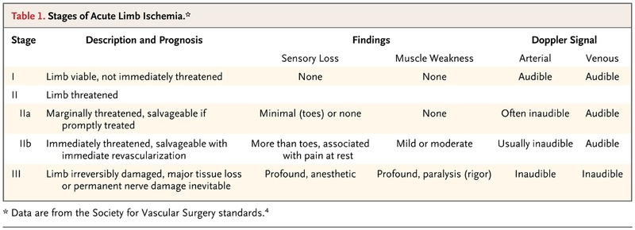
Staging

Slide 29
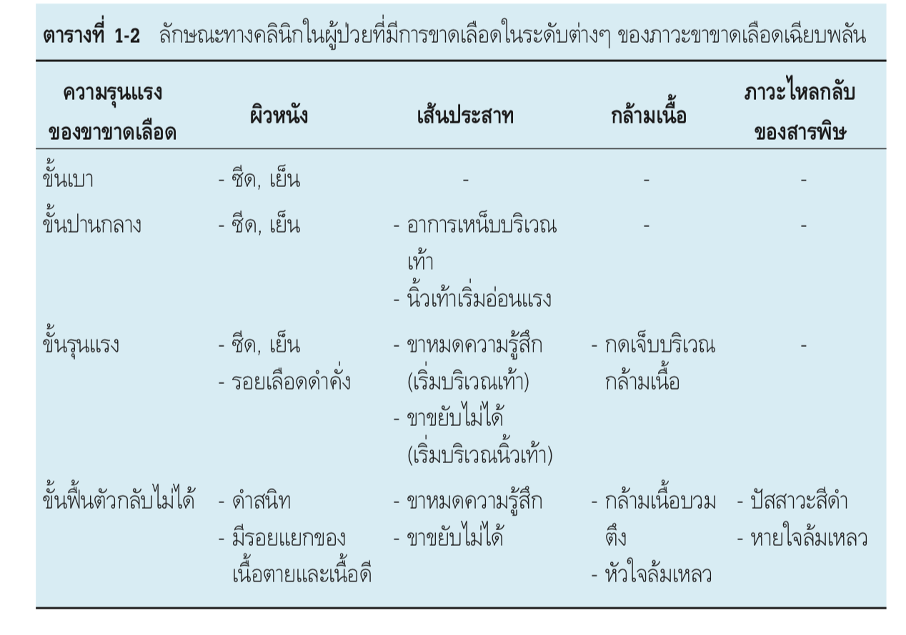
Classification

Slide 30
Management
Initial management = Prevent further clot
Anticoagulation = Heparin*** as soon as diagnosis
5000-10,000 Unit IV bolus ( 80 U/kg)then cont. drip 15-18U/kg/hr.
Keep aPTT x 2-3

Slide 32
Treatment
Endovascular treatment : Thrombolysis,percutanoeus mechanical thrombectomy
Surgical treatment : Embolectomy
Amputation

Slide 33
Endovascular treatment
Thrombolysis
SK, TPA

Slide 34
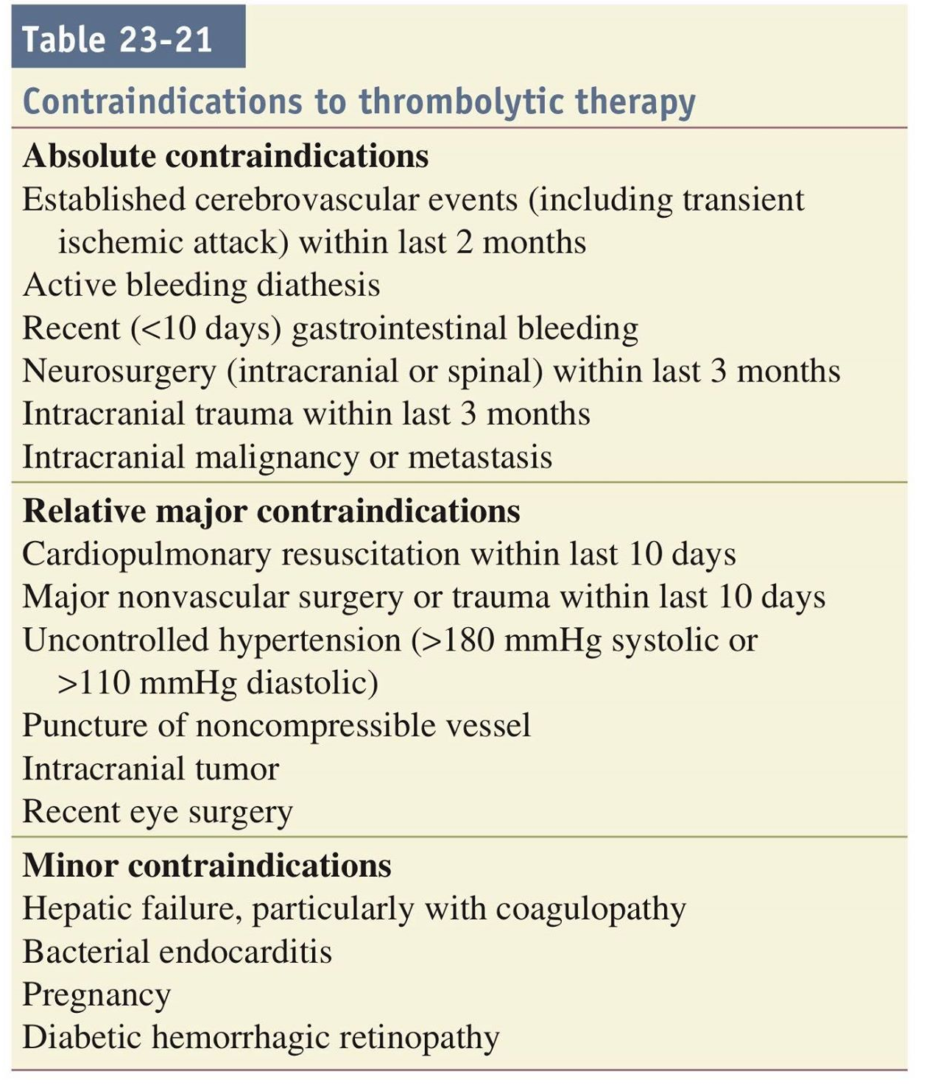

Slide 35
Surgical treatment
Embolectomy
Bypass graft thrombectomy

Slide 36
Complications
Bleeding due to thrombolytic agents
Reperfusion and compartment syndrome
• Arterial rethrombosis

Slide 37
Thank you

